Slide 1

System Design & Analysis
PHASE three
4.10.2024

Slide 2
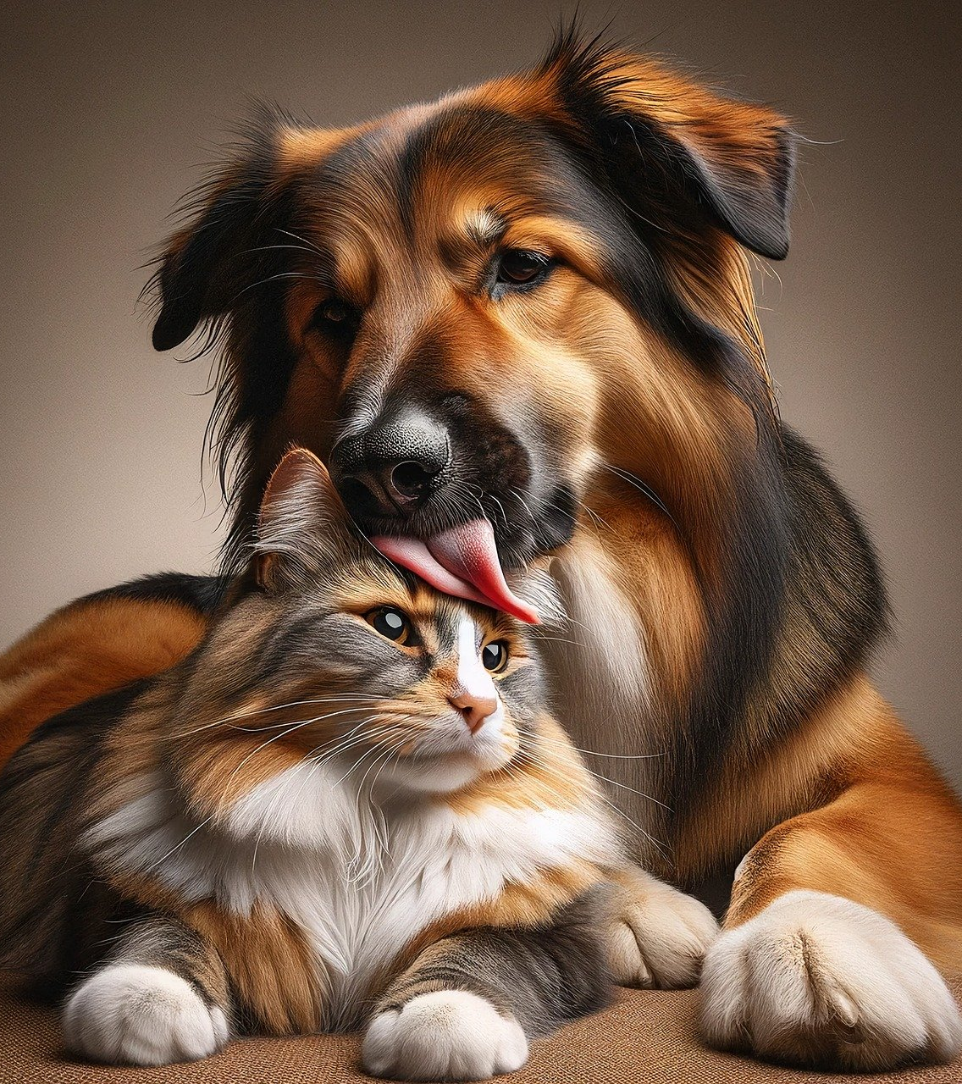
“We’re not to blame for your pet’s bad name”
PET NAMER
Would you like help picking a name for your pet?
Simply upload a picture and we’ll recommend a few different names for you!

Slide 3

Technology
VSCode IDE
Python 3.11.8
Django
Azure AI API
SQLite3
Google authentication

Slide 4
Phase 3 updates
We worked on:
Understanding how Django and Python work together
Learned that the implementation of the Django/Python combo to our IDE, VSCode, has a built in SQL database that we can access through the website admin page instead of needing to use a separate SQL application
How to integrate and implement the Azure AI image recognition API

Slide 5
Overview
Landing page
Login screen with account creation
Picture upload screen
Picture recognition response with name suggestions from designated databases based on the animal species recognized

Slide 6
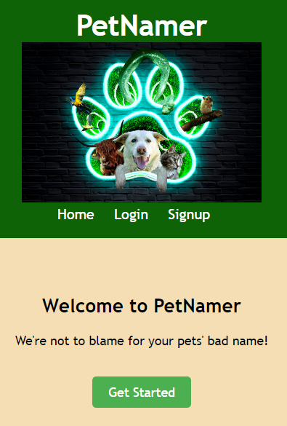
Landing page
The first page seen if the domain was www.petnamer.com
Greeted by adorable animals that we have name databases for: dogs, cats, birds, snakes, cows, and hamsters.
Get started takes you to the login/account creation screen
Logo created by Carl

Slide 7
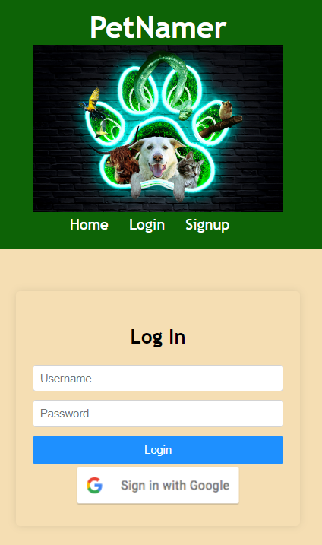
LOGIN page/ account creation
In order to receive pet name suggestions a pet owner will need to create an account and log in
The pet owner will have the option to use their Google account or create a local account on the website

Slide 8
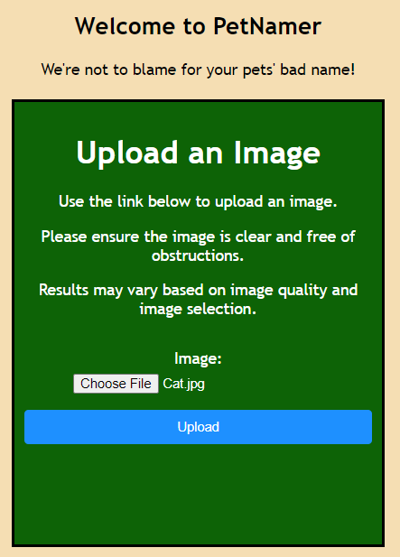
Upload a picture of your pet
The pet owner will click on Choose File
They will then need to upload a picture they have already taken and saved to their local device
In this screen shot Adria has uploaded a picture of her cat

Slide 9
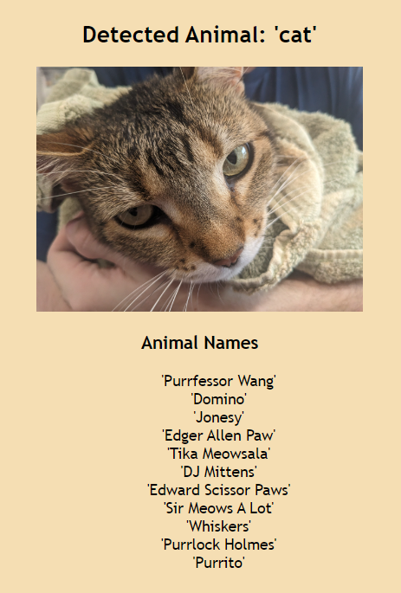
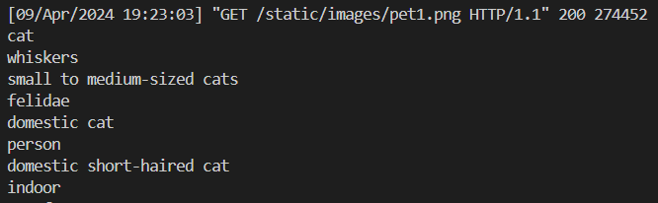
Image Recognition
Azure backend recognition response:
‘cat’ was sent to our database
and the name suggestions were returned

Slide 10
LIVE presentation
Team 1: Phase Three

